Slide 1
Computational Discoveries of Humankind
Luonnonfilosofinen seura
Tieteiden talo 15th May 2018
Kimmo Kaski
Aalto University School of Science, Finland
Alan Turing Institute, British Library, UK
Wolfson College, University of Oxford, UK
Complexity Science Hub, Vienna, Austria

Slide 2
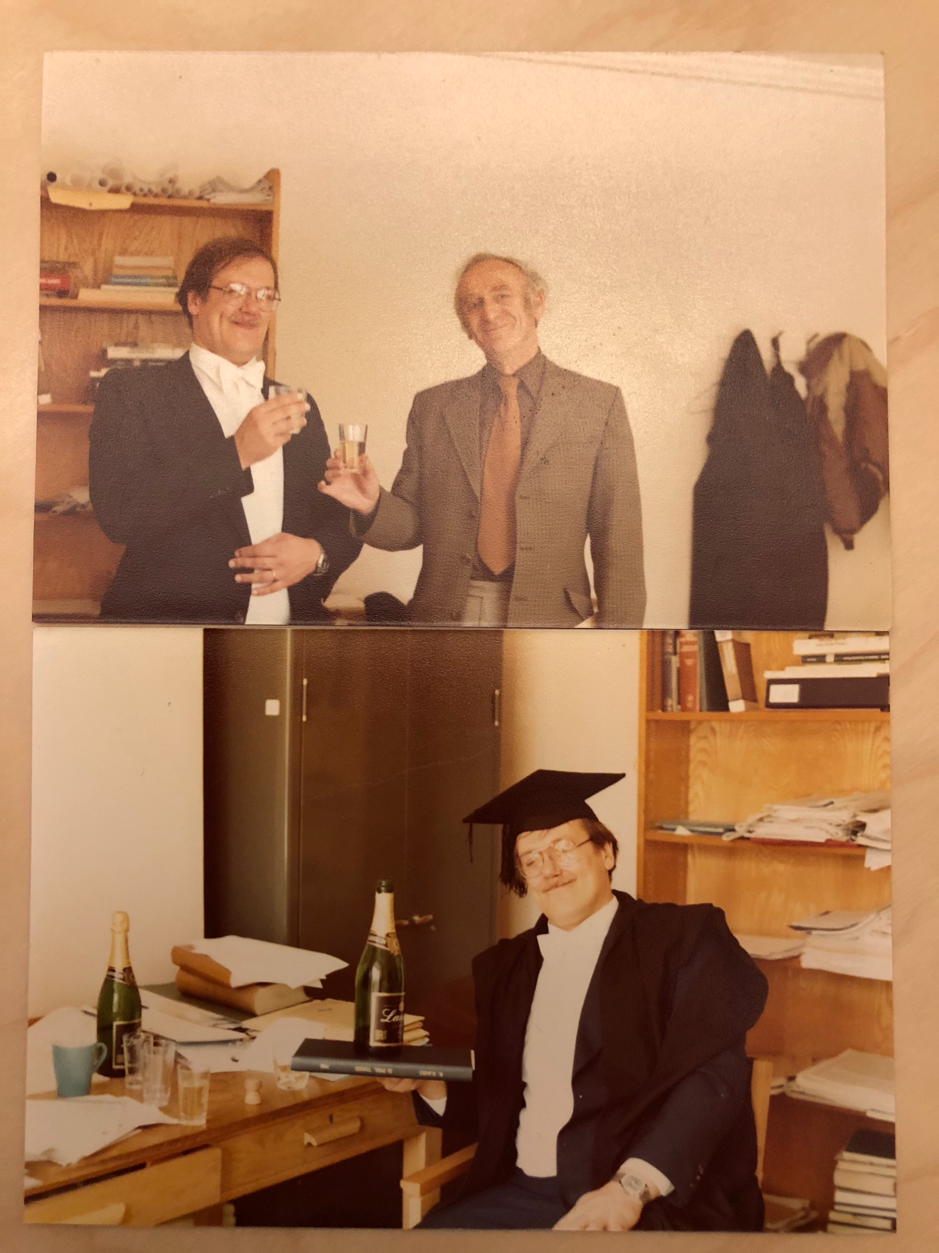
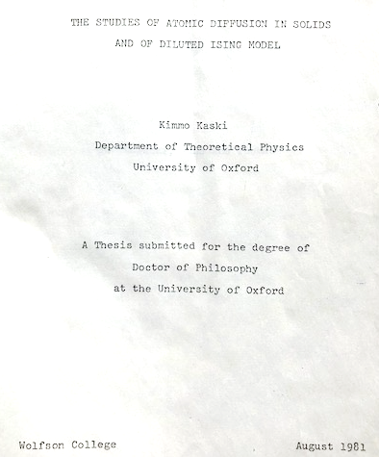
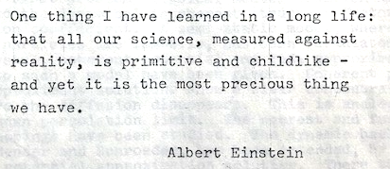
Computational Discoveries of Matter and Humankind
Helsinki Univ. of Tech: MSc 1973, Lic.Tech. 1977; Oxford 1978-81: DPhil

Slide 3
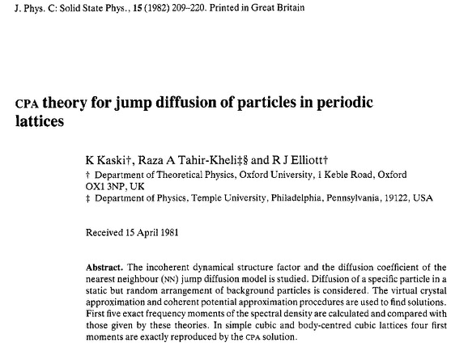
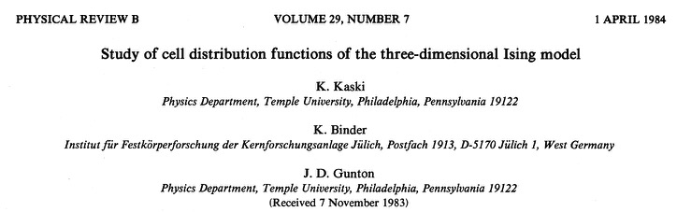
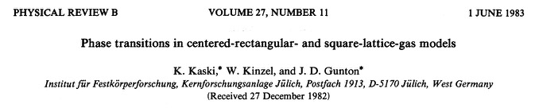
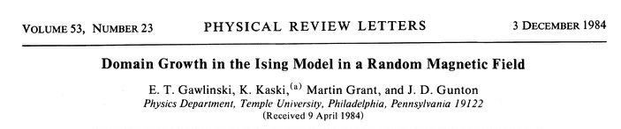
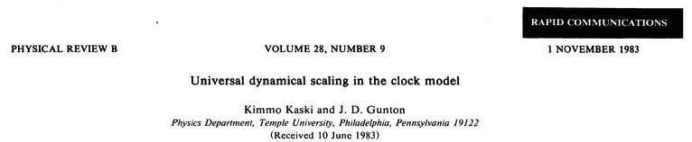
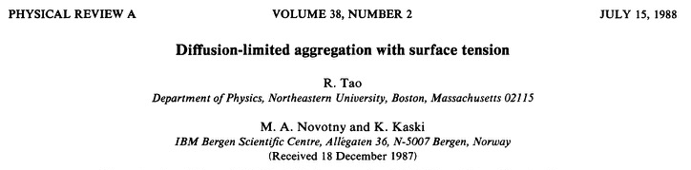
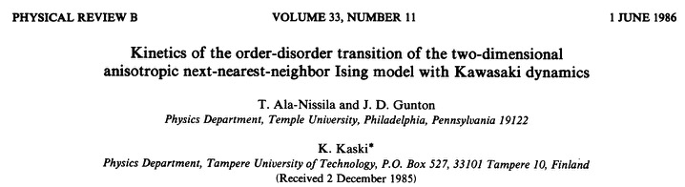
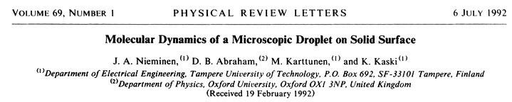
Computational Discoveries of Matter and Humankind
Temple U. & Geneva U. & KFA Julich & TUT & IBM Res.Ctr & Oxford U. & UH & HUT /Aalto

Slide 4
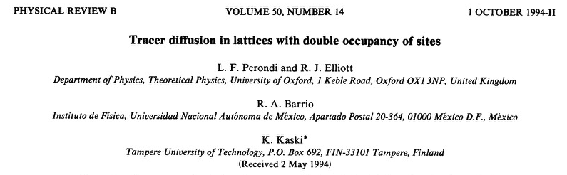
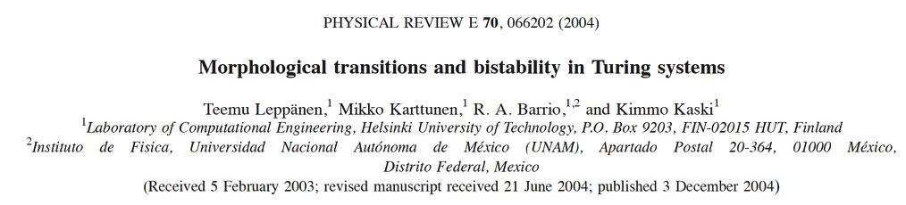
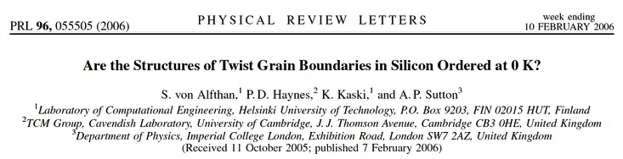
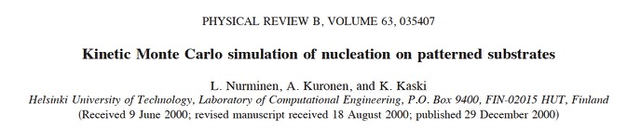
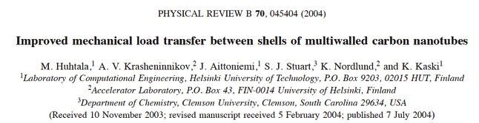
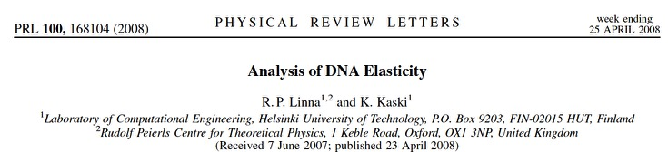
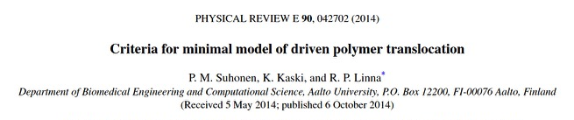
Computational Discoveries of Matter and Humankind
Temple U. & Geneva U. & KFA Julich & TUT & IBM Res.Ctr & Oxford U. & UH & HUT /Aalto

Slide 5
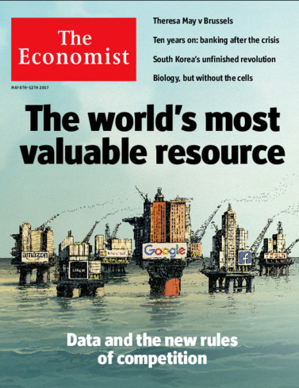
Computational Discoveries of Humankind
Digitalisation & ICT => Big Data => Insight into Human Sociality, Social Structures and Dynamics
Data is the new oil
“Data is like crude oil, valuable only if refined,
i.e. analyzed to have value.”
Data will be currency and power!
Digital Data-driven Disruption
Expanding Digital Universe:
2025: 180 zetta-bytes/y
Internet transfer: 450 My

Slide 6
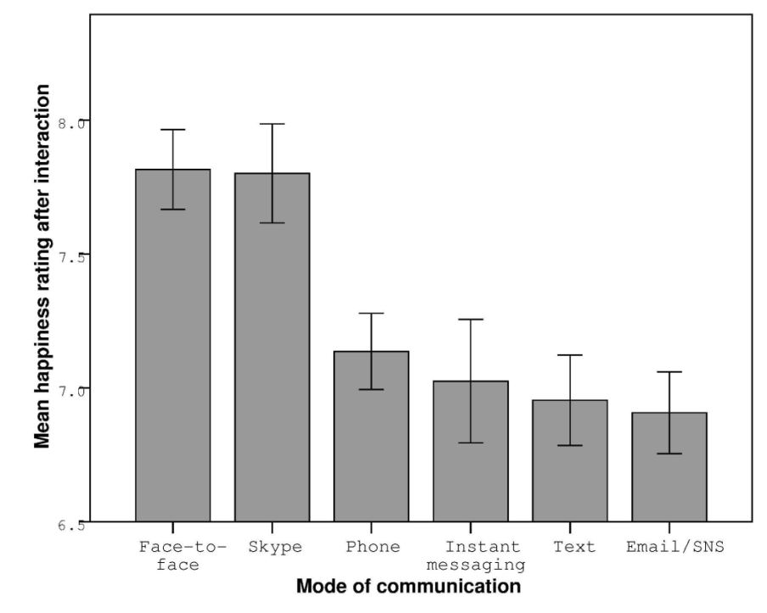
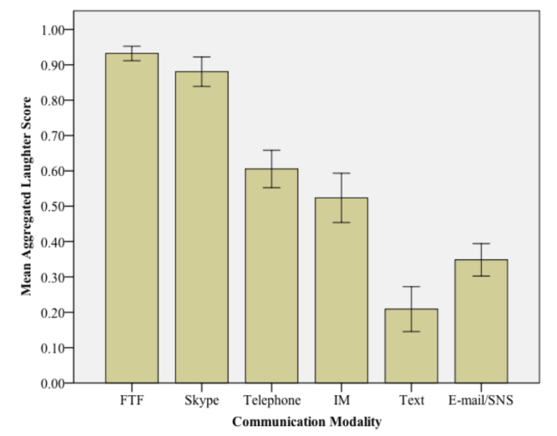
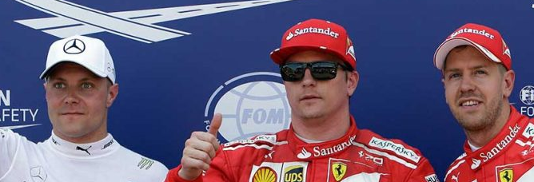
Dunbar: Just How Good is the Digital World?
Sociality in ICT-based World
Happiness Rating
Laughter
Mean happiness after interaction
Mean Aggregated Laughter Score
F2F Skype Phone IM Text Email/SNS
Mode of Communication
F2F Skype Phone IM Text Email/SNS
Communication Modality
Finland
Happiest
country
Two happy
Finns!
For perceived happiness & laughter rates:
F2F and Skype are better than all other media

Slide 7
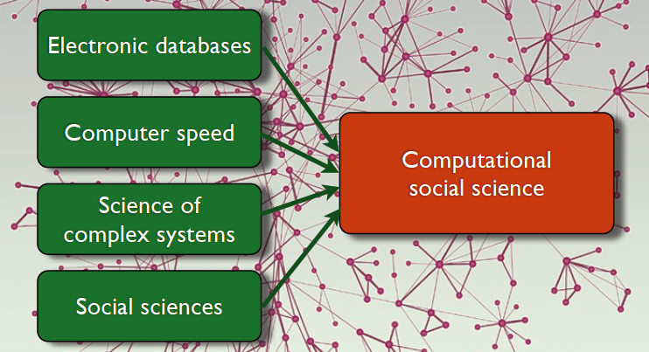
Computational Approach to Human Sociality
Challenge: the underlying laws of social system – if any – are not know, yet!
Digital databases
Big Data
Computer speed
HPC
Computational Social Science
or
Social Physics
or
Data-Driven Social Science
Science of
Complex Systems
Social Sciences
Properties: Structure -- Function -- Response
Methods: Analysis -- Modelling -- Simulation

Slide 8
Dataset
Socially relevant in vivo Dataset
Insight into behaviour at Individual to societal level
Large mobile phone operator data set from a European country:
~ 10 million service subscribers
~ 3 billion calls
~ 500 million text messages
Covers 12 months period (2007)
In addition demographic data:
  Gender of subscriber
  Age of subscriber
  Postcode of subscriber
  Most used tower position
Other (open access) dataset:
  Seasonal (temperature) records
  Geophysical (sunrise & sunset, daylight duration) records
  Country statistics (city populations, distribution…)
From “Prehistoric” era prior to smart phones, SNS like Facebook, etc.
  Single+ channel events (calls & SMS) with #, duration & timings reflect ego-alter sociality & social structure -> Phone network serves as proxy for social network.

Slide 9
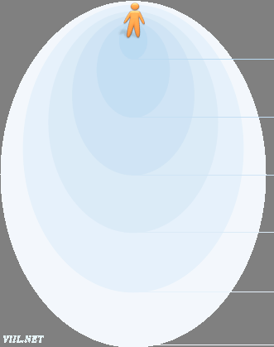
Egocentric Networks:
Sex Differences in Intimate Relationships
Homophily – a strong tendency for individuals to associate with others whom they perceive as being similar to themselves in some way.
Dunbar’s perspective
Support clique
(3-5 people)
Sympathy group
(12-20 people)
Band
(30-50 people)
Assortative mixing by degree in social networks.
Clan (150 people)
Dissortative mixing by genders in a network of sexual contacts.
Megaband
(500 people)
Tribe (1500 people)
Are there gender and age specific properties in our social relations?
V. Palchykov, K. Kaski, J. Kertész, A.-L. Barabási & R.I.M. Dunbar, Scientific Reports 2, 370, (2012)

Slide 10


Gender correlations: 1st & 2nd best friend
Degree of Friendship:
frequency of contacts between an ego and alters
Average gender of the best friend:
Male:
Ego
Alter
Female:
1st best friend
2nd best friend
Men and women between 18 and 45 have best friends of the opposite sex and the 2nd best friends are generally of the same sex
Women are more focused on opposite sex relationships than men

Slide 11
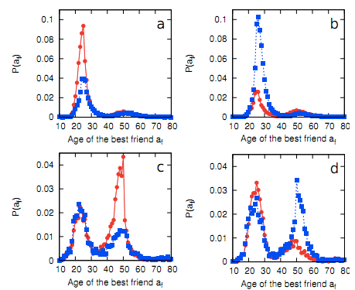
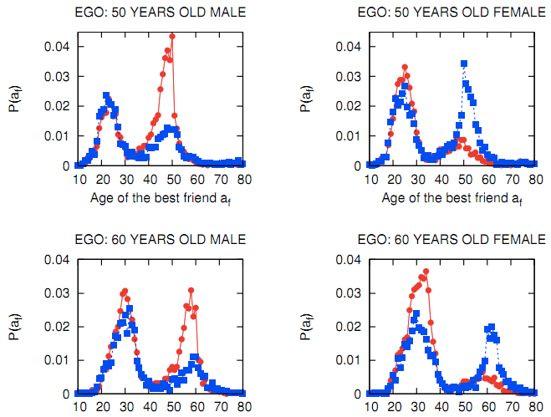
Age distributions of the best friend
Distribution of best friends by age
As people age their attention shifts from
the spouse to the children
Women are more active in maintaining family relationships
The mother-
daughter link is particularly strong.
Ego: m25
Ego: f25
Ego: m50
Ego: f50

Slide 12
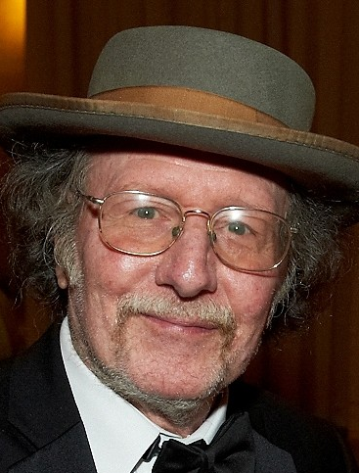
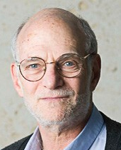
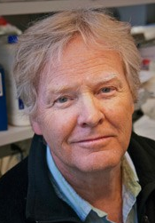
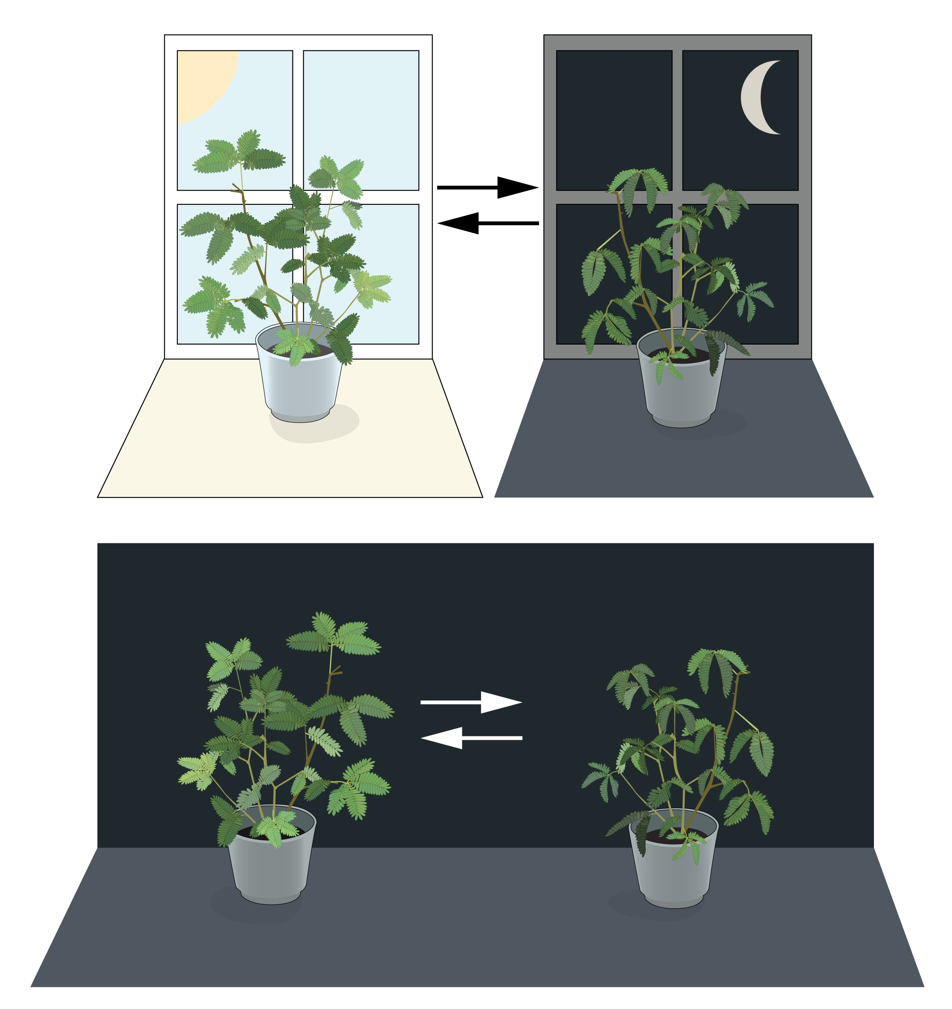
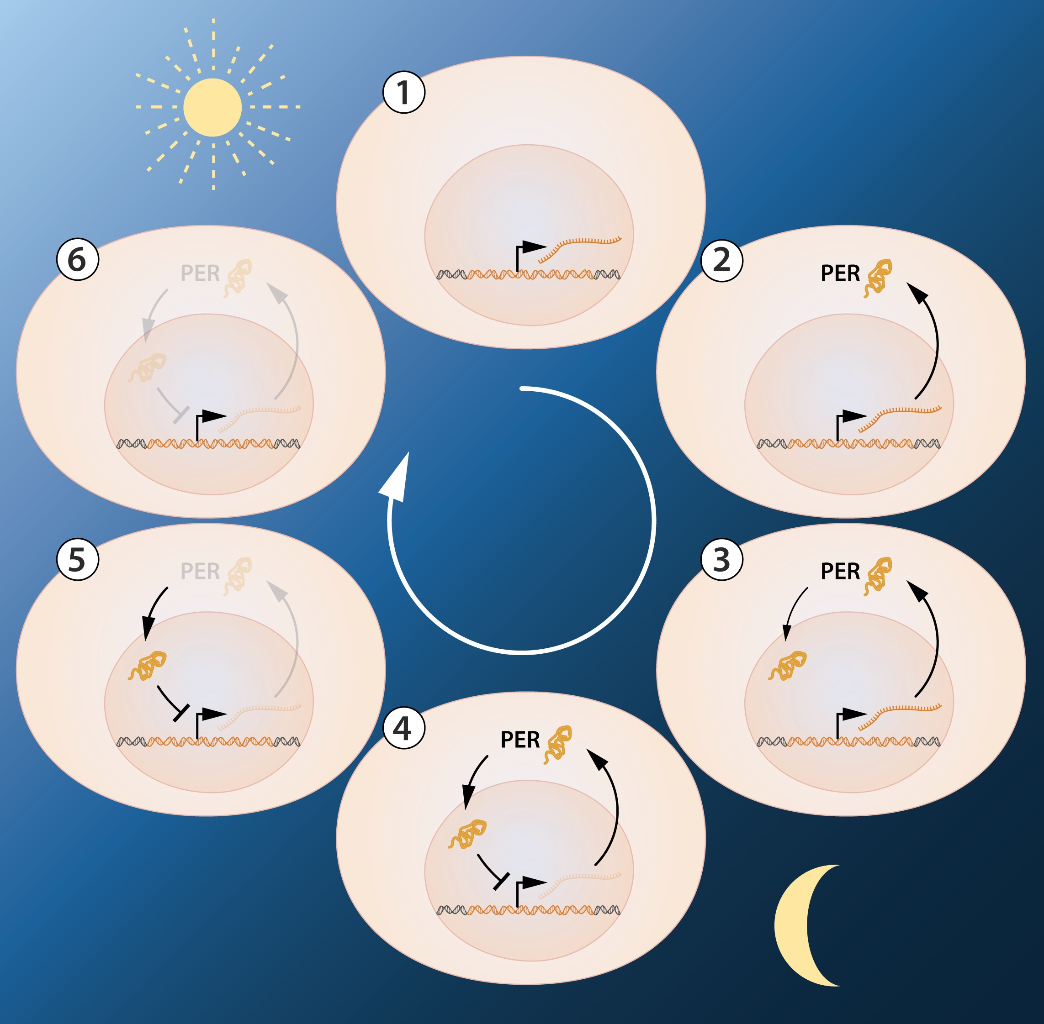

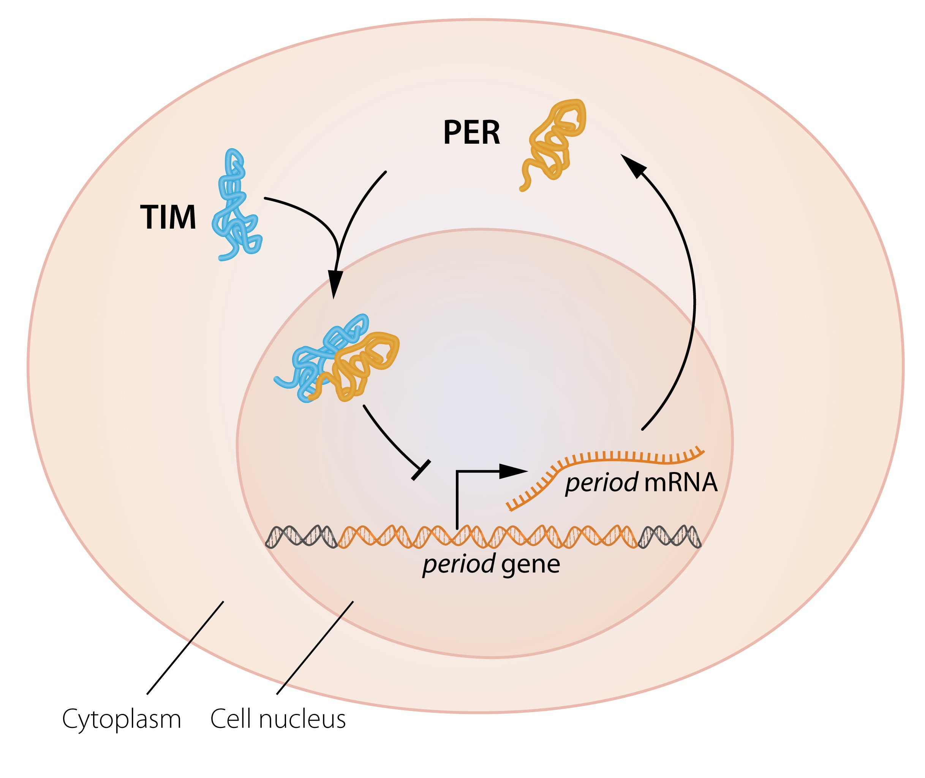
Circadian rhythms - 2017 Nobel Prize in Medicine
for their discoveries of molecular mechanisms controlling the circadian rhythm
Internal biological clock:
Molecular regulation:
At dusk period gene becomes active, generating period mRNA trans-ported to cytoplasm, producing PER-protein accumulating in the nucleus, to block gene activity: inhibitory feed-back underlying circadian rhythm.
J. C. Hall
M. Rosbash
M. W. Young
The PER protein reaches nucleus due to a 2nd clock gene, timeless, encoding TIM protein bounding with PER, to enter nucleus, delayed by a 3rd gene, doubletime, encoding the DBT protein for adjusting the oscillation to match a 24-hour cycle.
24h circadian rhythm:
interplay of 3 genes
Mimosa
Opens the leaves towards the sun during day & close at dusk.
Jean d’Ortous de Mairan (18th century astronomer) placed the plant in constant darkness and found that the leaves continue to follow their normal daily rhythm.

Slide 13
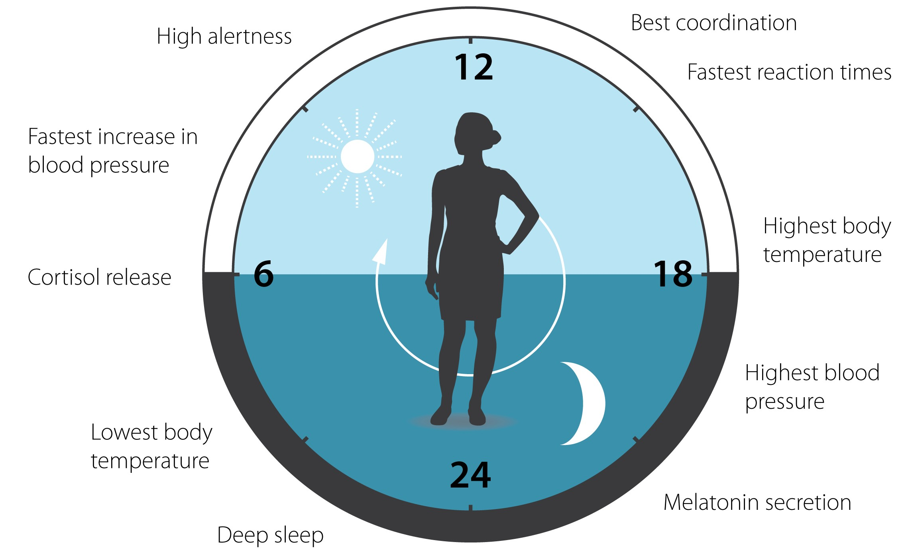
Circadian Clock in Human Physiology
The circadian clock anticipates and adapts our physiology to the different phases of the day:
Regulates sleep patterns, feeding behavior, hormone release, blood pressure, body temperature.
High alertness
Best coordination
Fastest reaction times
Fastest increase in
blood pressure
Highest body
temperature
Cortisol release
High blood
pressure
Lowest body
temperature
Deep sleep
Melatonin secretion
Role of environmental factors, human characteristics and societal structures?

Slide 14
Human Daily Rhythms
Low Calling Activity reflect periods of Resting or Sleep
---- Last call
---- First call
---- All calls
Distribution of outgoing calls along the day in a city, for two sets of consecutive days in 2007; All calls (Green); Only the last call of the night (Blue); Only the first call in the morning (Red). On day 46 (mid-Feb) T_{night} =10.5 h & day 214 (early Aug) T_{night} = 9.5 h.

Slide 15
Conclusions
Human Daily Rhythms
Afternoon break duration vs. ambient temperature
Relation between the afternoon break period T_{break} and ambient temperature θ for 12 different cities located in three latitudinal bands 37ºN, 40ºN, and 42.5ºN (each point (T_{break} , θ) represents a day).
By clustering a cold day without an effect and warm day with an effect on T_{break} we determine θ* = 18–25 C.

Slide 16
Conclusions
Human Daily Rhythms
Daytime and Night-time resting patterns
Daily low calling activity times reflecting the resting periods round the year for Tuedays, Saturdays and Sundays, for 12 cities at latitudes 37ºN, 40ºN, and 42.5ºN (4 cities each) where:
T_{break} = diurnal resting time,
T_{night} = nocturnal resting time,
T_{rest} = T_{break}+T_{night} = total resting times.
T_{rest} stays unaltered year round!

Slide 17
Conclusions
Human Daily Rhythms vs. Geo-location
Longitude Dependence in Urban Environments
Probability distributions of the time of last call and of the first call for 5 different cities lying at the same latitude but different longitudes. (top) Actual distributions. (bottom) Shifted distributions with a time shift proportional to the longitudinal angle difference.

Slide 18
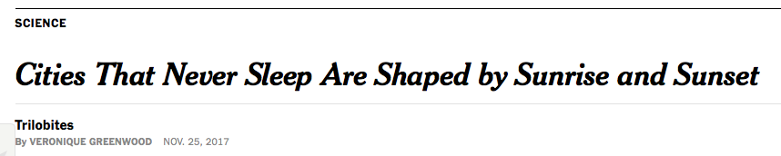

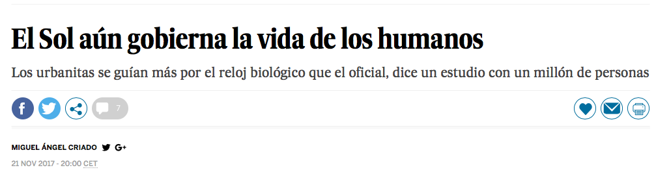

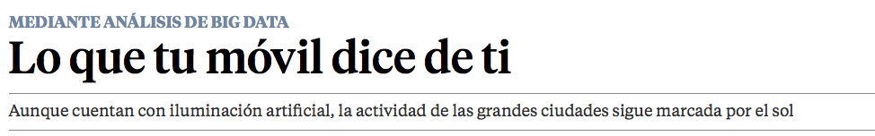

Conclusions
References & Media
D. Monsivais, K. Bhattacharya, A. Gosh, R.I.M. Dunbar & K. Kaski, „ Seasonal and geographical impact on human resting periods”, Nature Scientific Reports 7, Article number: 10717(2017)
D. Monsivais, A. Gosh, K. Bhattacharya, R.I.M. Dunbar & K. Kaski, „Tracking Urban Human Activity from Mobile Phone Calling Patterns”, Plos Computational Biology, Arxiv:1704.06187 (physics.soc-ph) (2017).

Slide 19
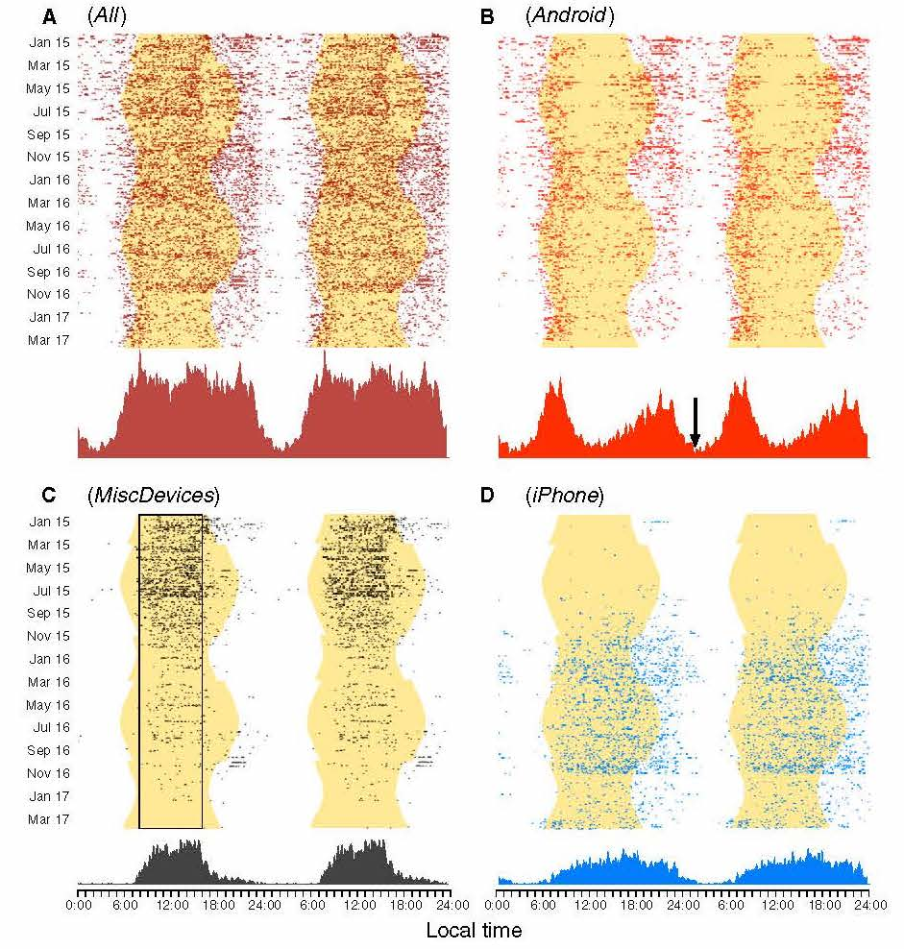
Conclusions
A Twitter study of the activities of a single person
T. Roenneberg: Twitter as
a means to study temporal
Behaviour, Current Biology
27, R825–R832,
September 11, 2017

Slide 20
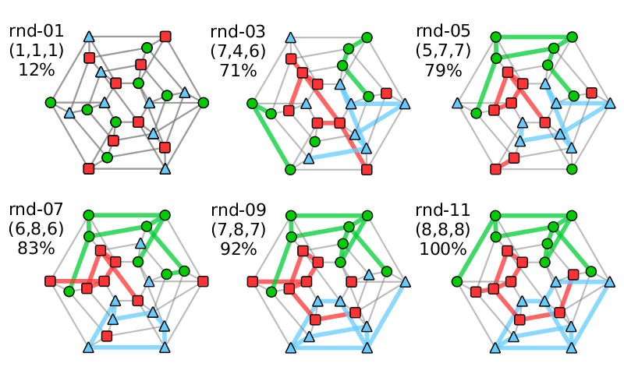
Conclusions
Cooperative Social Network Game
Human Players vs. Social Bots
Cooperative game in a network of N = n x M players assigned with n different colors aim to form n fully-connected communities by exchanging places with neighbors.
Cooperative Social Network Game
Experiment with 30 Human Subjects
Simulation with 30 Social Bots
Progress
Progress
Activity
Activity
Round
Round

Slide 21
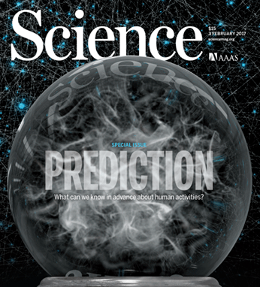
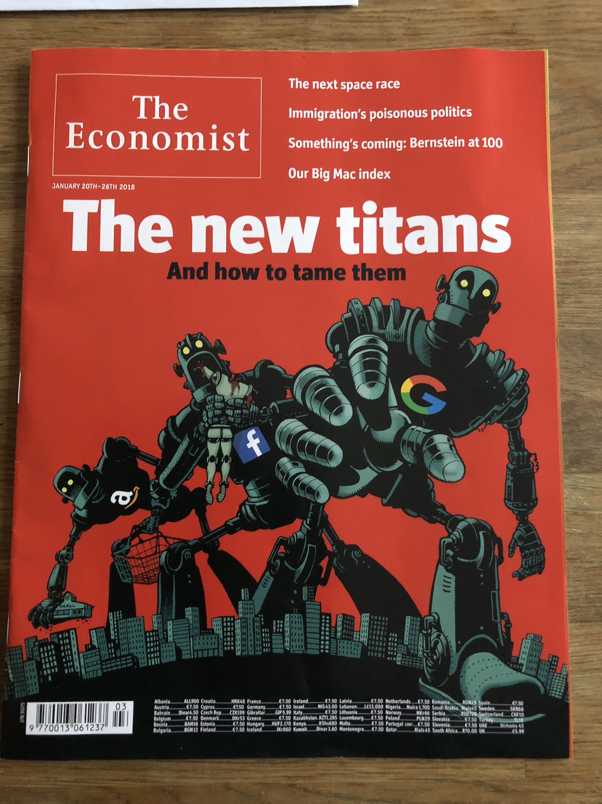

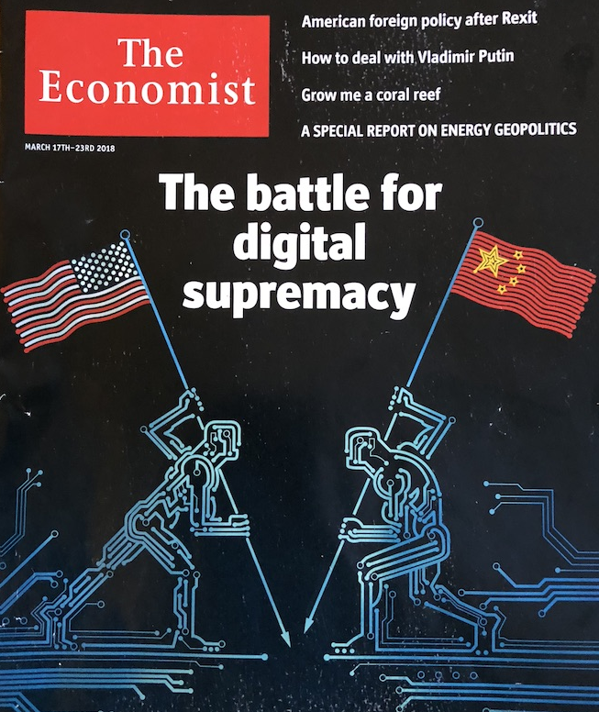

Computational Studies of Social Systems
ICT ➪ new perspective to social Network analysis
➪ Computational Data-driven Social Science
Conclusions
Computational & Data-driven Social Science
Structure -- Function -- Response
Analysis -- Modelling -- Simulation
What next?
Asimov’s Foundation - Psychohistory:
Hari Seldon, a mathematician and psychologist, developed psychohistory a new field of science and psychology that equates all possibilities in large societies to mathematics, allowing for
the prediction of future events.
Artificial Intelligence
Notes:
21

